Slide 1
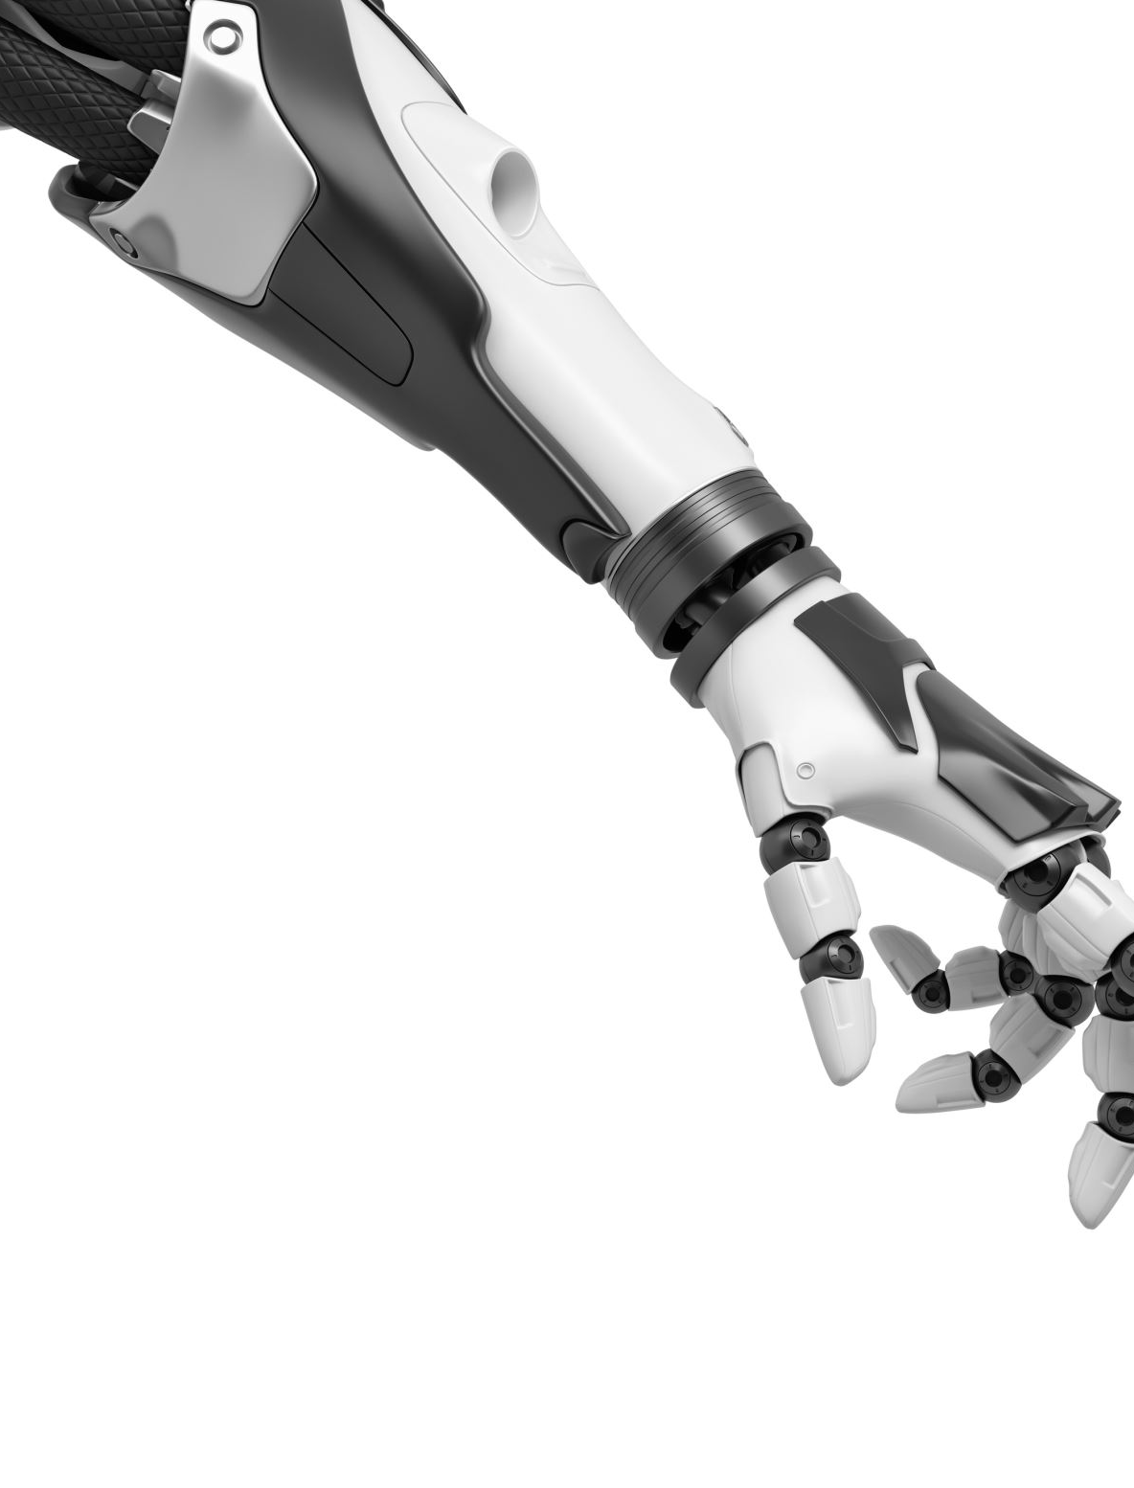
Android Remote Controlled Vehicular Robotic Arm
Team Members
Alan Devkota
Adarsh Jain
Swetha Velpula
Isham Sarjil Ahsan

Slide 2

As the demand for robots is increasing and are being integrated into working tasks to replace humans in both industrial and service areas. Therefore, we propose a model of vehicular robotic arm. In this project, a vehicular robotic arm is made and controlled by an Android mobile app. The control of this model is through ESP32 along with a mobile phone for controlling the robot. This prototype may be expected to overcome the problems of picking hazardous objects or non-hazardous objects that are far away from the user and where displacement of very heavy objects is needed from one place to another as automation is required in many industries.
Abstract

Slide 3
Section 1: Components

Slide 4
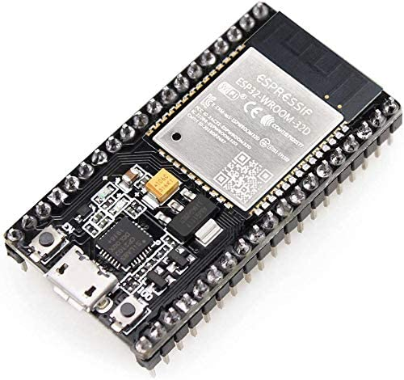
Device hardware components: ESP 32
ESP32 is a series of low-cost, low-power systems on a chip microcontroller with integrated Wi-Fi and dual-mode Bluetooth.
It receives the signal as string and sends the control signal to the h-bridge motor driver.
It consists of processors, memory, wireless connectivity, peripheral interfaces (Ethernet, touch sensors, Motor PWM etc.)
It is cheaper than Raspberry Pi and can perform multiple functions.
It is feasible to use for low power small applications.

Slide 5
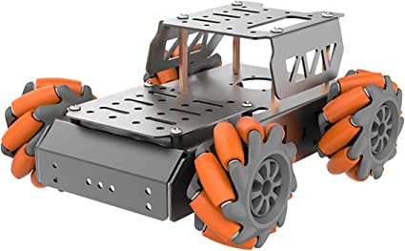
Device hardware components: Mecanum wheels
The chassis car kit uses the latest mecanum wheels for movement.
It moves in any direction and run perfectly in narrow spaces and on rough ground.

Slide 6
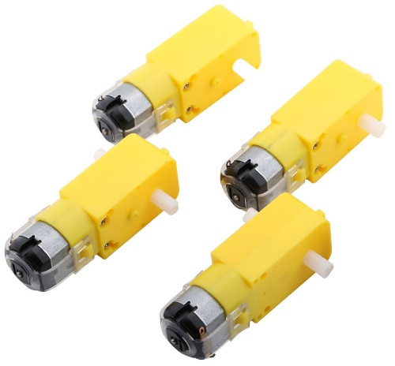
Device hardware components: TT Motors
It is a type of DC motor which converts the Direct Current (DC) electrical energy to mechanical energy.
The reduction ratio of the motor is 1:120, output voltage 3-6V.
It has higher starting torque, quick starting and stopping, variable speeds with voltage input.

Slide 7
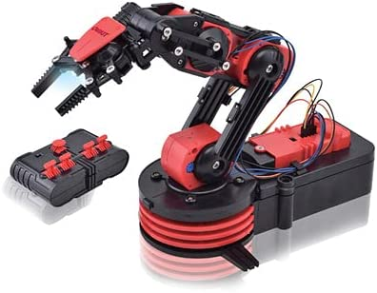
Device hardware components: Robotic arm
A robotic arm is a type of mechanical arm, usually programmable, with similar functions to a human arm; the arm may be the total of the mechanism.
The links of such a manipulator are connected by joints allowing either rotational motion (such as an articulated robot) or translational (linear) displacement.
The links of the manipulator can be considered to form a kinematic chain.

Slide 8
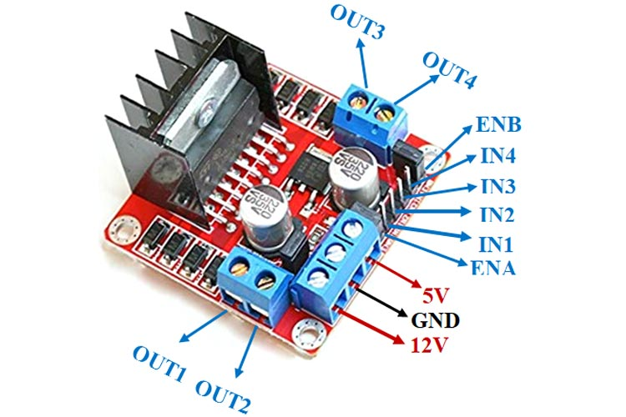
Device hardware components: Motor Driver
Motor drivers acts as an interface between the motors and the control circuits.
Motor require high amount of current whereas the controller circuit works on low current signals.
So, the function of motor drivers is to take a low-current control signal and then turn it into a higher-current signal that can drive a motor.

Slide 9
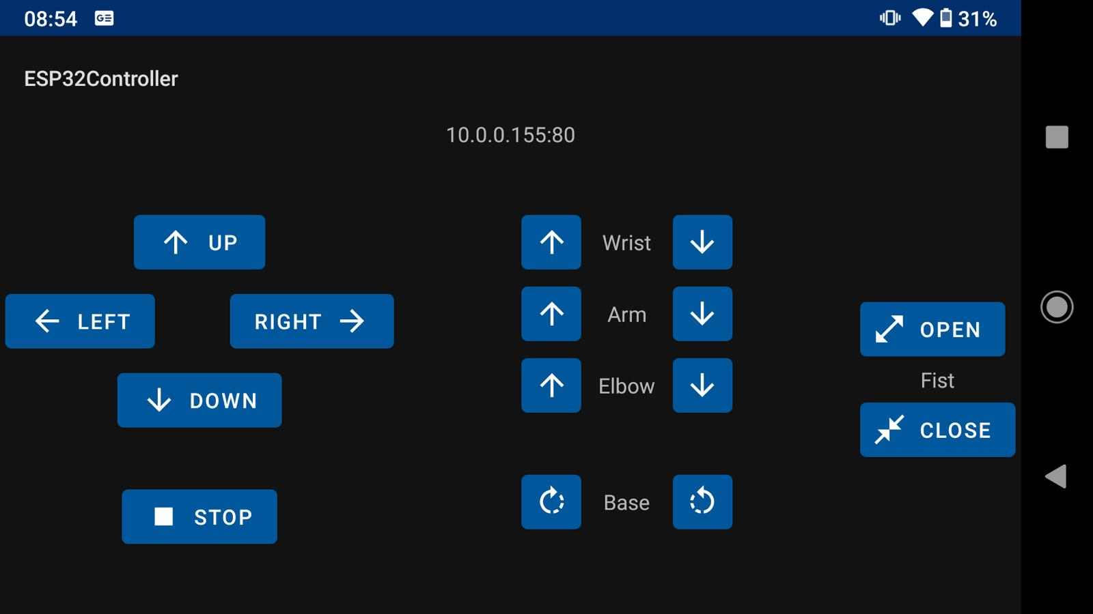
Device Software Components: Android App
Controls the movements of the arm and wheels of the chassis through ESP32.

Slide 10
Device Software Components: Arduino IDE
Used to operate the ESP32 with the vehicular robotic arm.

Slide 11
Section 2: Methodology

Slide 12
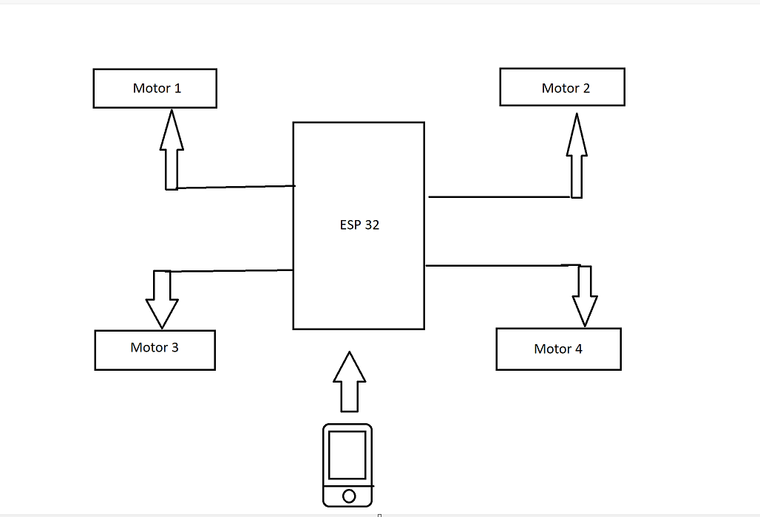
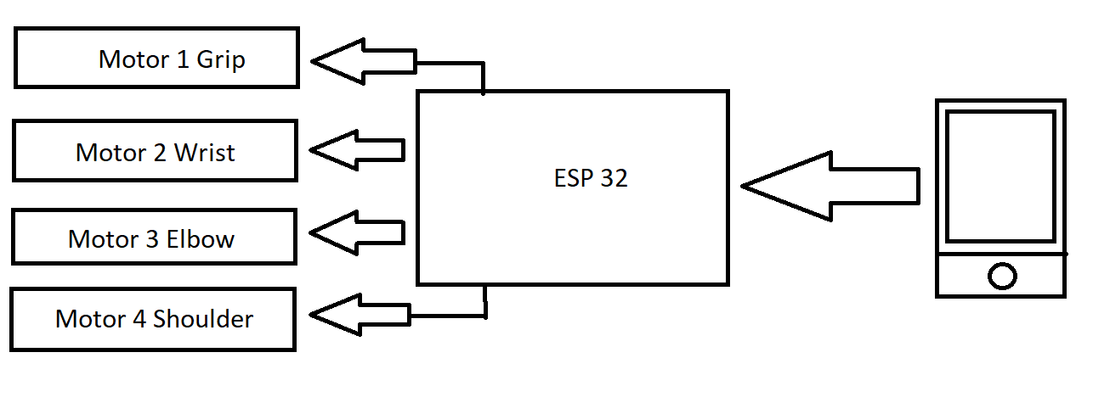
Methodology
Block Diagram of chassis
ESP 32
Android Mobile App
4 Motors of chassis
Block Diagram of robotic arm
ESP 32
Android Mobile App
4 Motors of Robot arm

Slide 13
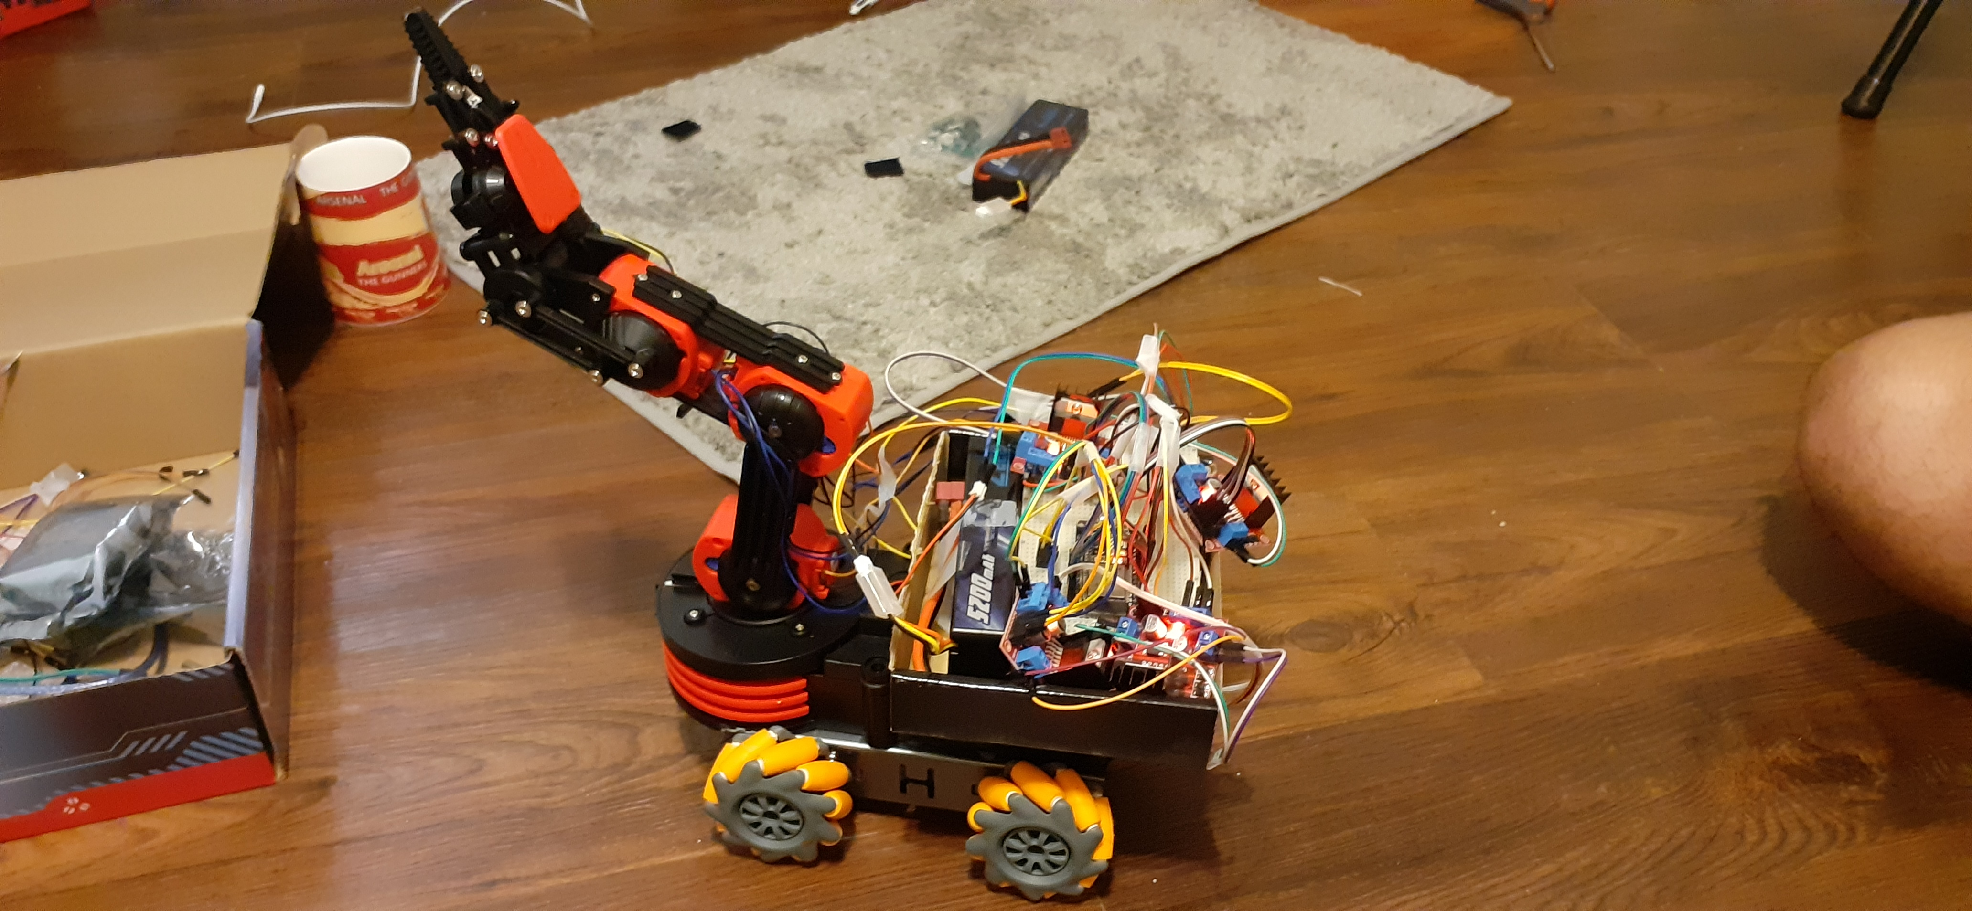
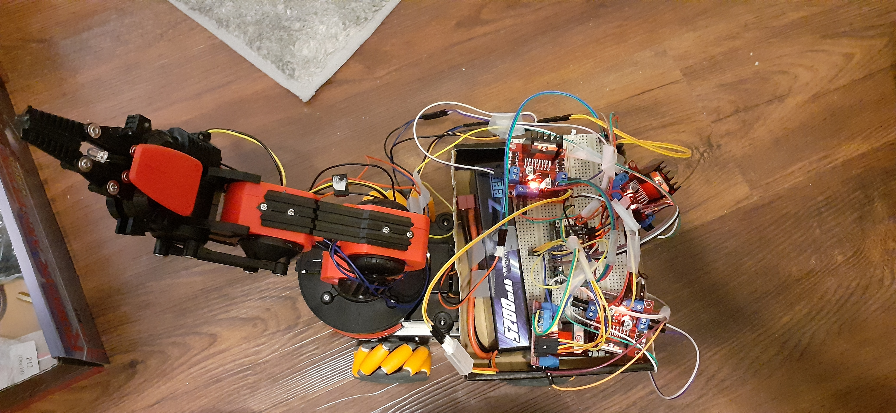
Device Circuit Diagram

Slide 14
Section 3: Applications

Slide 15
Decent battery backup which makes it a mobile device to be used in any situation without requiring power supply from the mains. Mobile app control makes the model suitable for replacing direct human contact for hazardous tasks such as chemical handling, bomb disposal, etc. Commendable weight carrying capacity of 5kgs. Mecanum wheels used in chassis which makes it suitable for operation on any terrain. Lightweight design which makes the model appropriate to be used in operations that require constant location change. WIFI control that enables real time robotic operation from a different location to the robot. User friendly android app interface which makes controlling the robot straightforward and uncomplicated.
Advantages of vehicular robotic arm

Slide 16
Mobile app control limited to Android, no IOS support. The robotic arm claw has only two grips which makes it unsuitable for picking up any circular objects (for example: a ball). Application in the industry is limited to only lightweight object lifting and maneuvering since the model has a weight carrying capacity of 5kgs. Uptime is reduced drastically in extreme cold climate since battery back up is reduced in such climatic conditions. Improper shielding makes the model unsuitable to be operated outdoors during rain, since there is potential risk of water damage to the esp32 and other sensors.
Disadvantages of vehicular robotic arm

Slide 17
Suited for use by Bomb Disposal Squad. Remotely pick up and move unidentified objects, which can be a bomb, to a secure location away from vicinity of people for safe disposal. Safety of the personnel ensured as they do not come in direct contact of the threat object. Our model being battery powered makes it a mobile device which can be used in any setting. Our model can be implemented into large warehouses to pick up and take goods to the delivery area. Single operator can remotely control the robot from a central control room. Lower overhead cost since less employees will be required. Men will be replaced by our model which would increase efficiency of warehouse operations since machines will not have fatigue like humans. Reduced risk of injury to employees in case of an accident since hazardous material such as chemicals will be handled by our model.
Applications of Vehicular Robotic arm

Slide 18
Section 4: Video

Slide 19
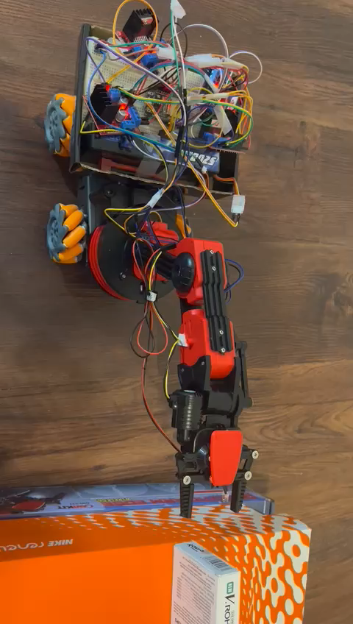

Slide 20
Thank You ajain42@cougarnet.uh.edu adevkot2@cougarnet.uh.edu iahsan@cougarnet.uh.edu svelpula@cougarnet.uh.edu

